Slide 1
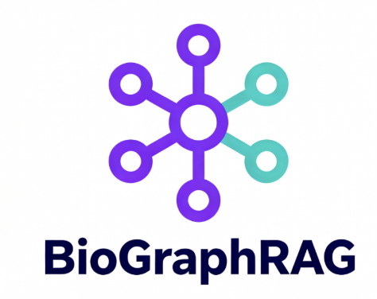
AWS Life Science Hackathon
10/1 – 10/3
Team 9:
Aymen Maqsood Mulbagal
Ben Stear
JP Courneya
Mina P. Peyton
Victor Felix
Arun Bondali
Michelle Holko

Slide 2
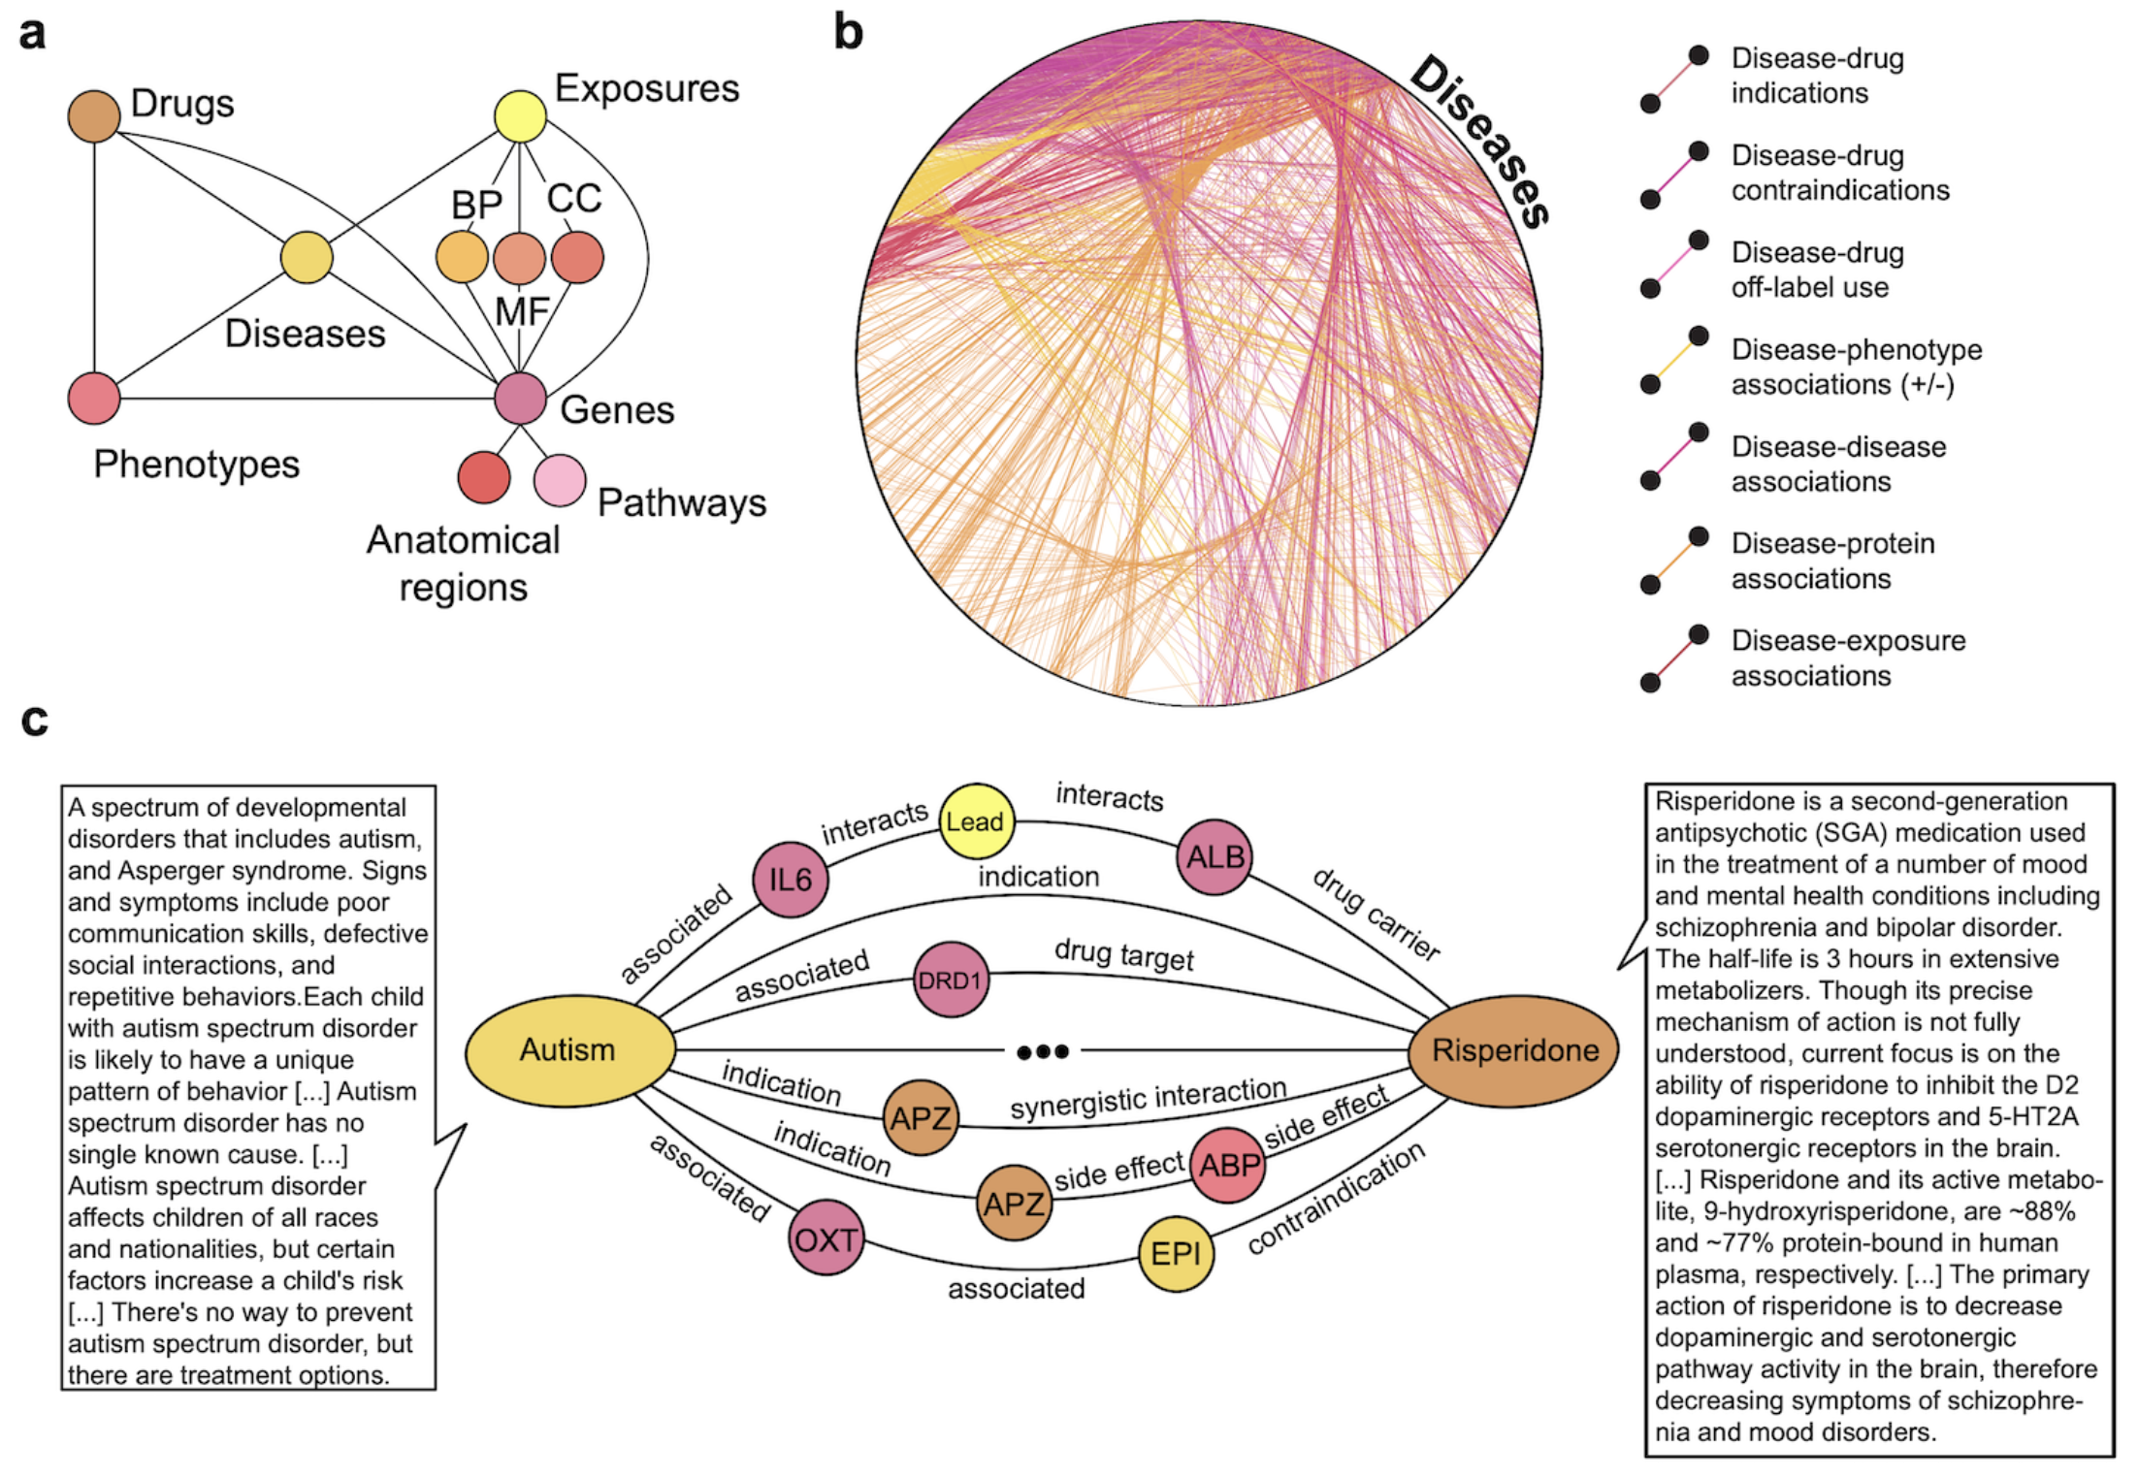
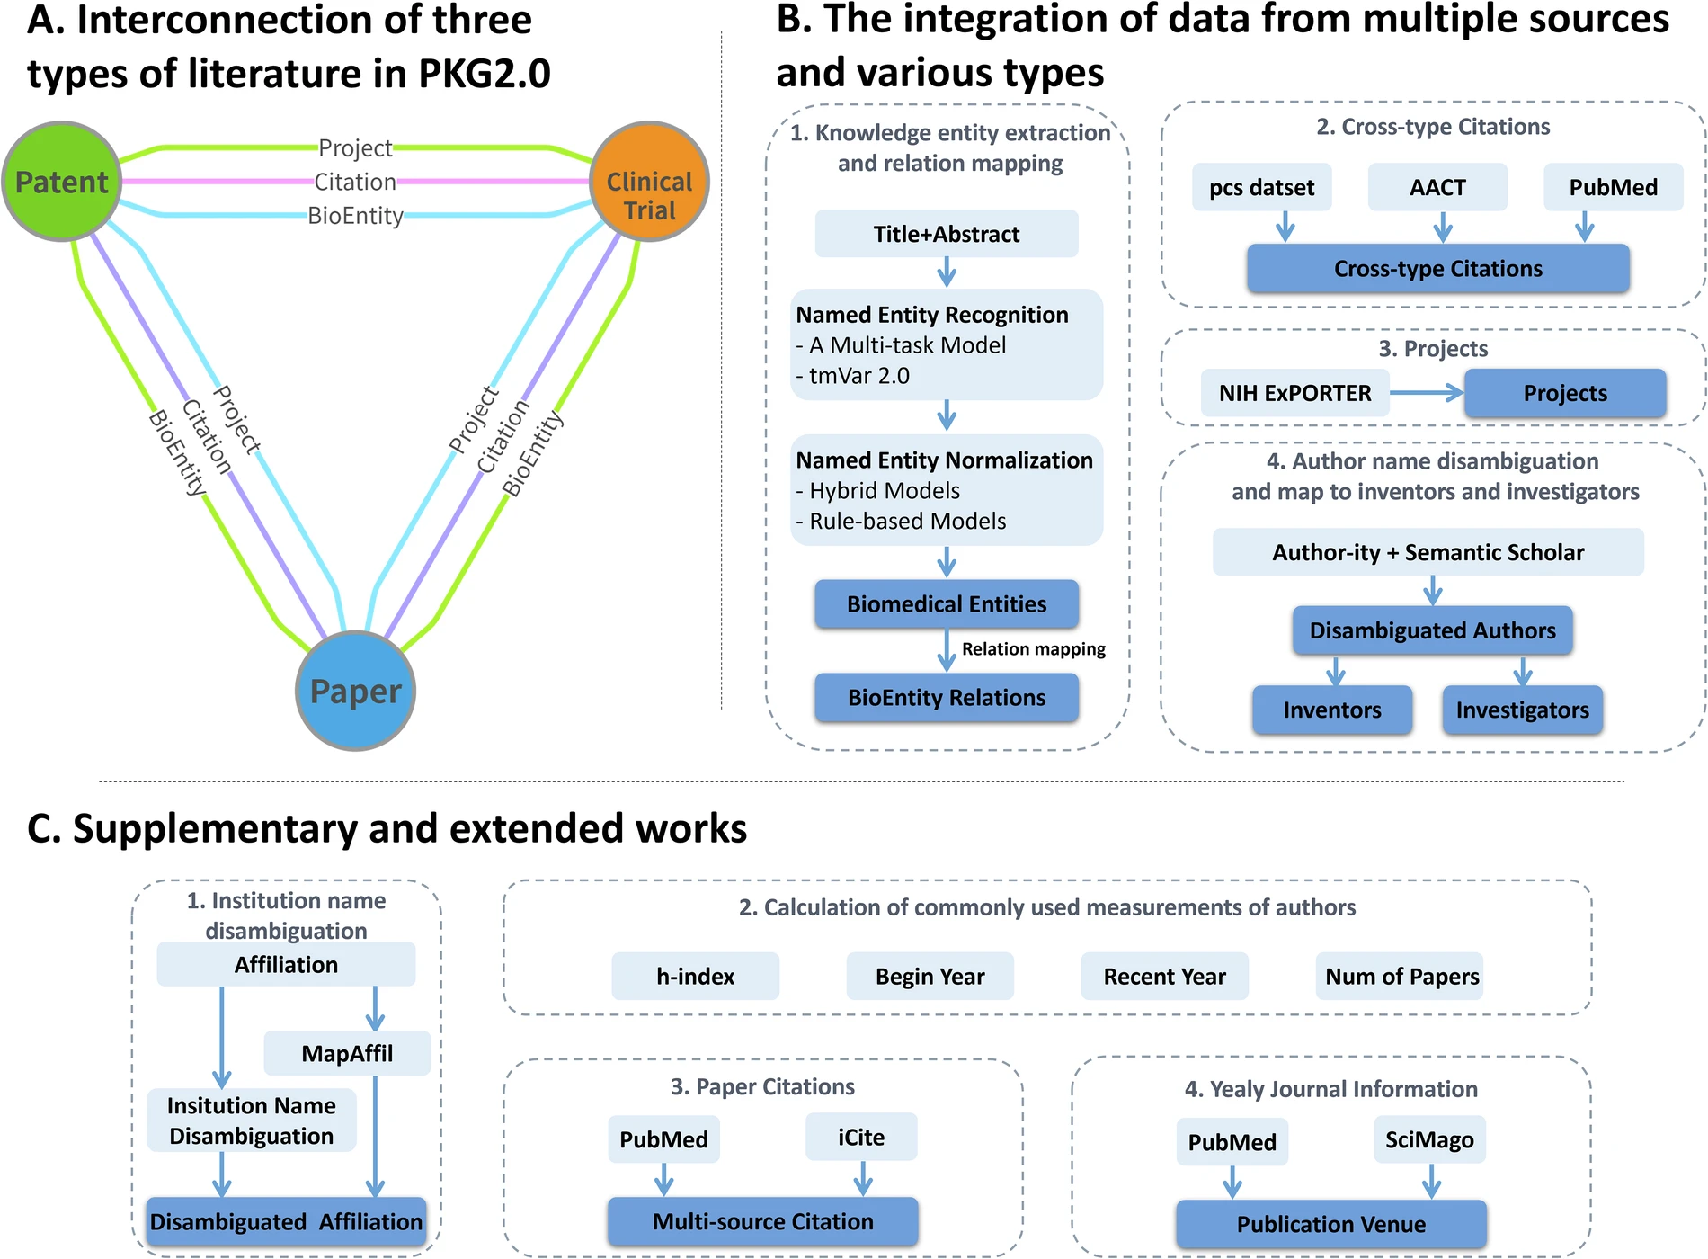
Precision Medicine Knowledge Graph (PrimeKG)
Pubmed Knowledge Graph (PubKG)
PrimeKG:
integrates 20 resources:
17,080 diseases with 4,050,249 relationships representing ten major biological scales
PubKG:
integrates papers, patents, and clinical trials as core data
connections between papers, patents, and clinical trials through bioentities, projects, authors, and citations
Chandak et. al., Scientific Data, 2023; Xu et. al., Scientific Data, 2025
Notes:
including disease-associated protein perturbations,
biological processes and pathways,
anatomical and phenotypic scale,
and the entire range of approved and experimental drugs with their therapeutic action

Slide 3
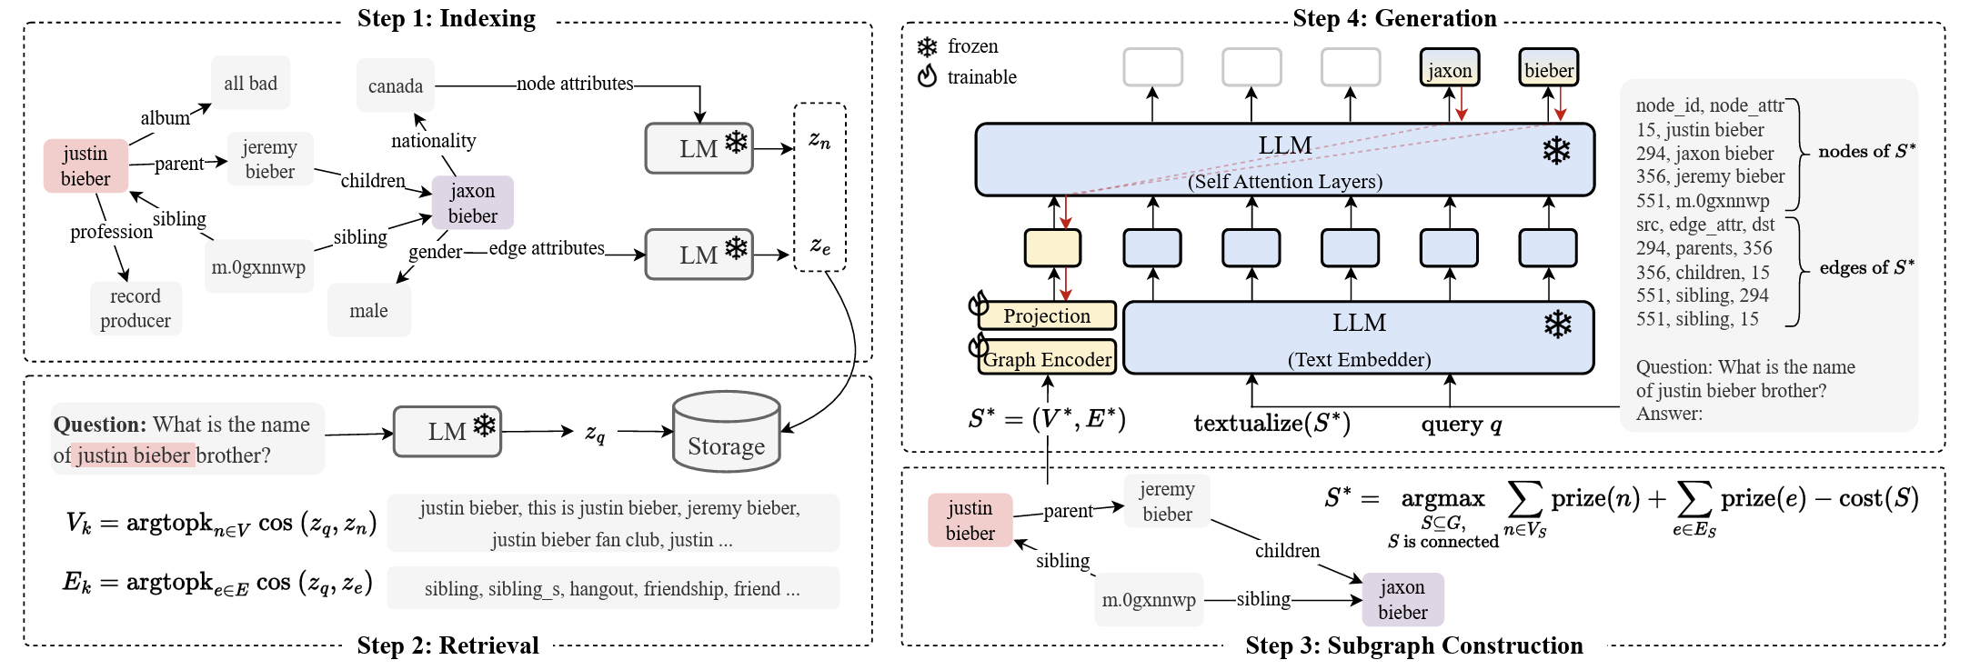
G-Retriever
He et. al., arXiv, 2024
Notes:
Figure 3: Overview of the proposed G-Retriever: 1) Indexing: Graphs are indexed for efficient query processing; 2) Retrieval: The most semantically relevant nodes and edges are retrieved, conditioned on the query; 3) Subgraph Construction: A connected subgraph is extracted, covering as many relevant nodes and edges as possible while maintaining a manageable graph size; 4) Generation: An answer is generated using a ‘graph prompt’, a textualized graph, and the query.

Slide 4
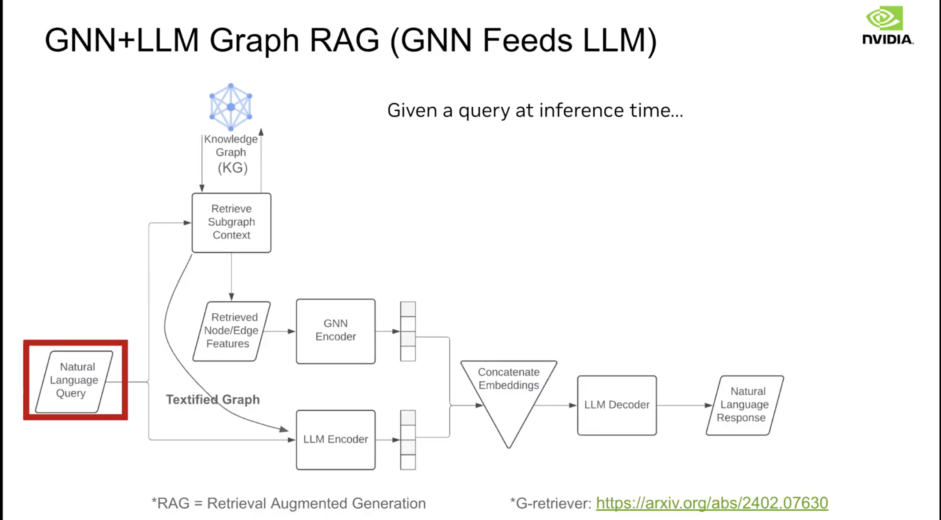
GraphRAG (GNN + LLM)

Slide 5
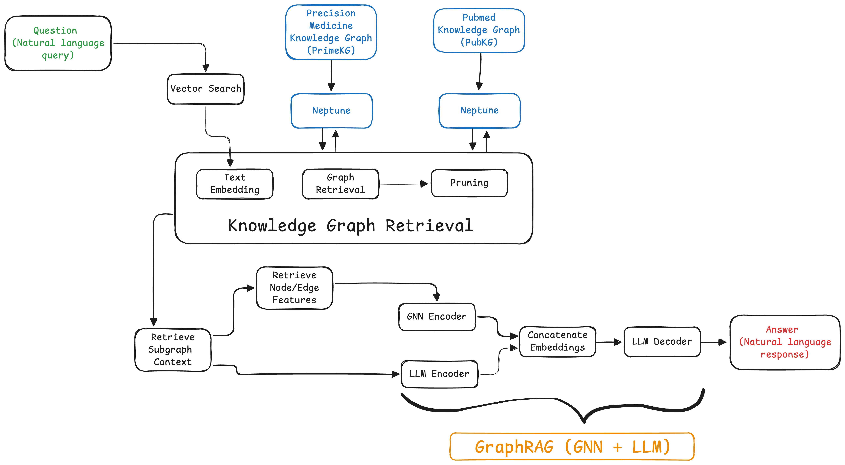
Workflow Overview

